Slide 1

E-commerce Conversion Rate Optimization Project
Sanmati Pol

Slide 2
Problem Statement, Impact
Problem Statement :
Observation from GA4 Funnel
Users move through: view_item → add_to_cart → begin_checkout → purchase.
Biggest drop-off occurs between add_to_cart → begin_checkout.
2. On mobile, this drop-off is even worse (e.g., 60% leave before purchase).
Impact
Many potential sales are lost because the checkout process is too long, confusing, or not mobile-friendly.
This directly affects revenue.

Slide 3
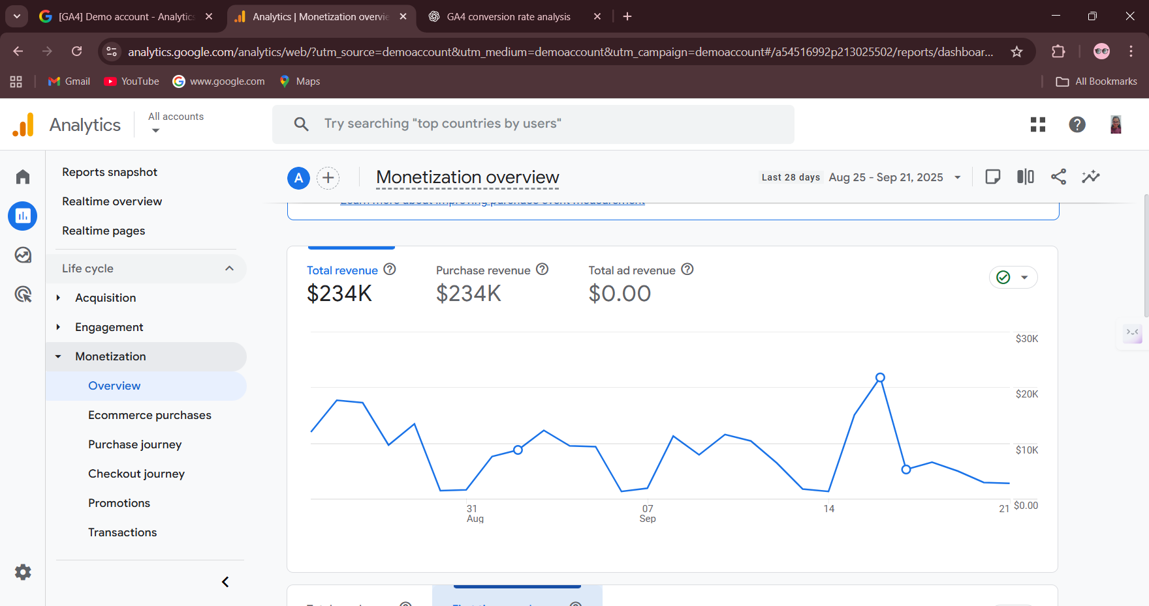
The Data (GA4 Analysis)
Screenshot 1: Revenue Trends (Line Graph: Months vs. Money)

Slide 4
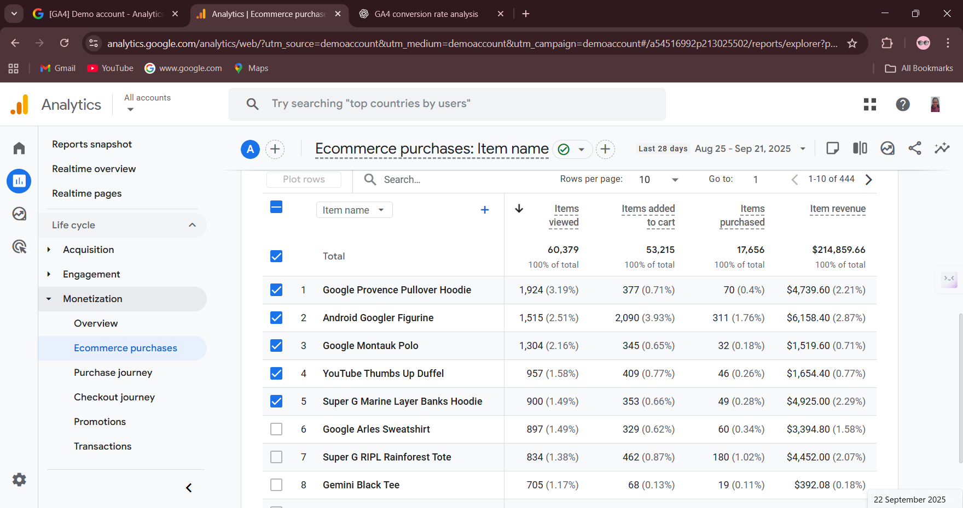
The Data (GA4 Analysis)
Screenshot 3: Top-Selling Products and Conversion Breakdown

Slide 5
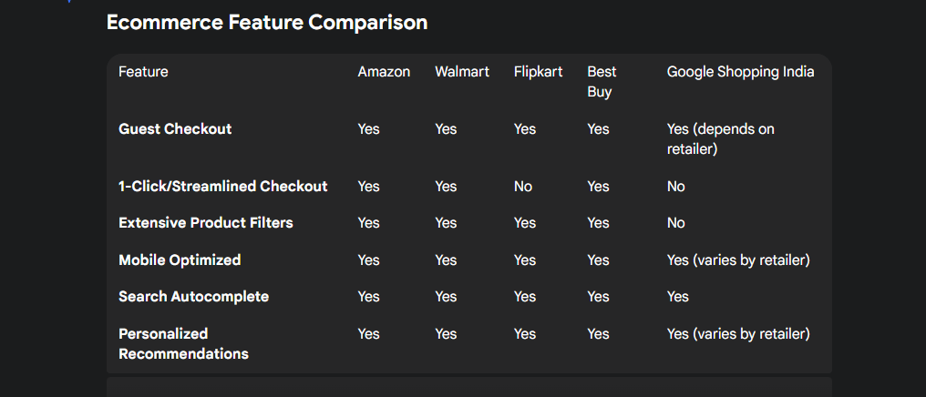
Competitor Research

Slide 6
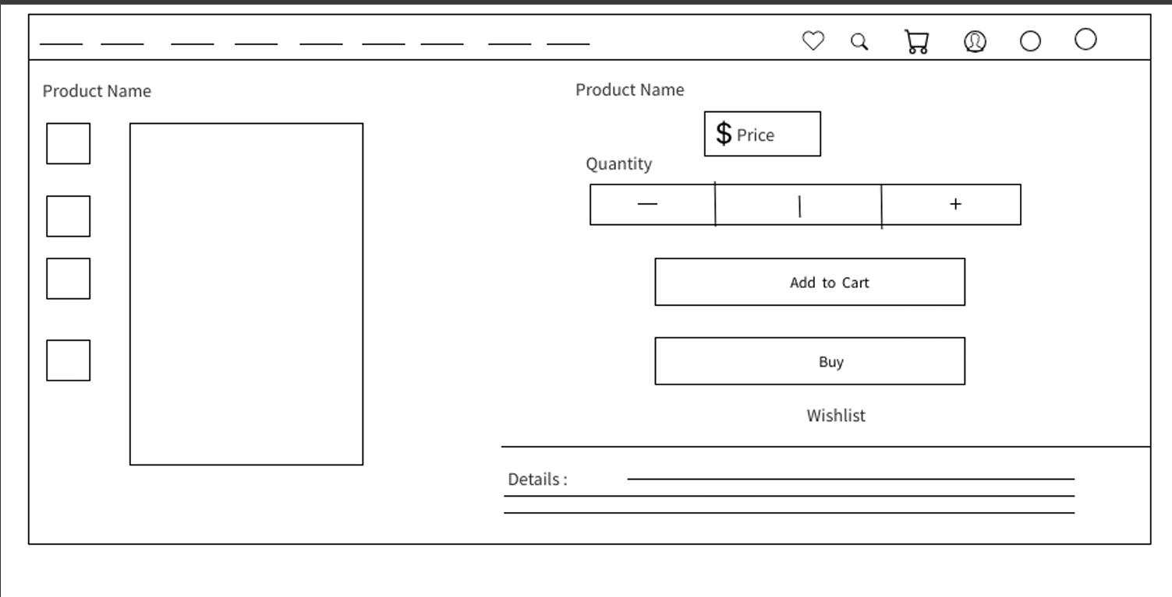
Proposed Solution
Wirefraame 1 : Adding ‘Buy’ Option below the cart option

Slide 7
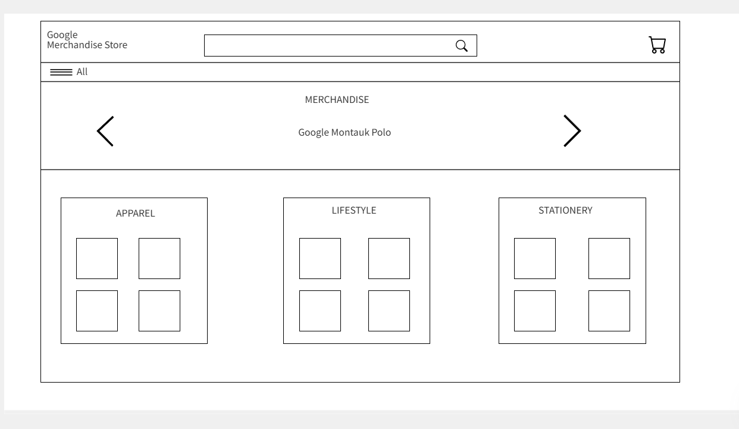
Proposed Solution
Wireframe 2 : Updated Home Page of Google Merchandise Store

Slide 8
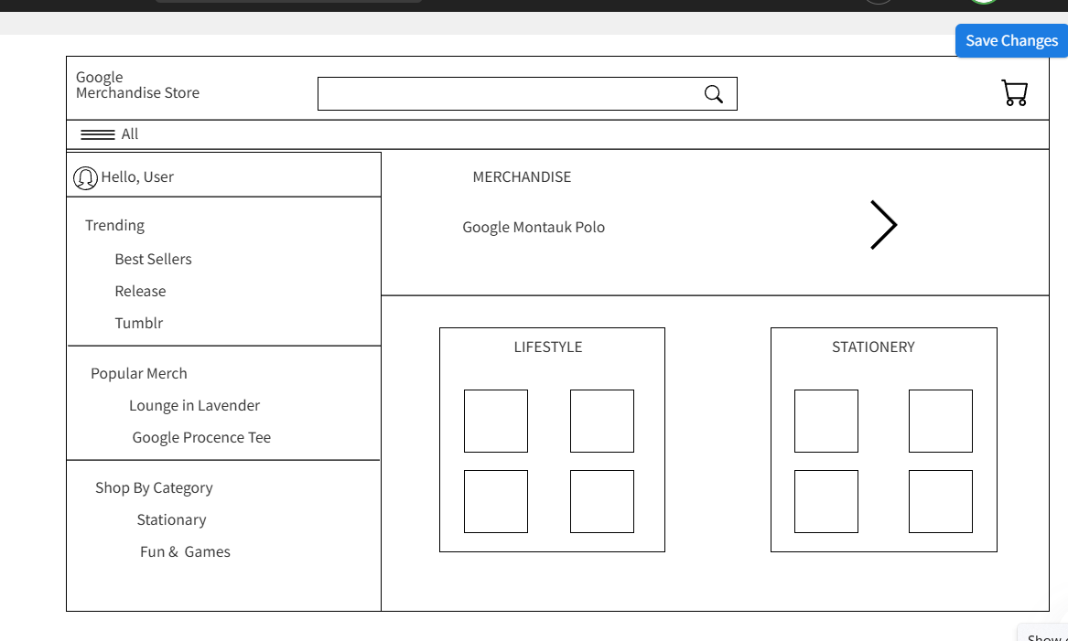
Proposed Solution
Wireframe 3: category Page Overlapped on home page

Slide 9
Optimizing mobile checkout and product filteringcan significantly improve conversion and revenue.
1️⃣ Business Impact (Demo Numbers)
Metric | Value
Monthly Purchases | 10,000
Average Order Value | ₹500
Current Monthly Revenue | ₹5,000,000
Projected Purchases (+5%) | 10,500
Projected Monthly Revenue | ₹5,250,000
Revenue Increase | ₹250,000

